Slide 1
Informal Report on Research into Predicting Credit Card Default Probability
Prepared by Dave Sullivan, Ph.D.
Credit One Data Science Team

Slide 2
Our goal: a tool to predict default probability
Our goal is to use a 30,000 record dataset with recorded outcomes for defaulting/not defaulting on payments with associated features of credit debt & payment, + some demographic information, to develop a math decision model to predict probability of defaulting for future customers.
We have a model from an earlier researched problem in this area by Dr. I-Cheng Yeh from Chung Hua University, Taiwan (Yeh, I. C., & Lien, C. H. (2009). The comparisons of data mining techniques for the predictive accuracy of probability of default of credit card clients. Expert Systems with Applications, 36(2), 2473-2480)
Preliminary examination of the data in MS Excel shows some practically & statistically significant differences in mean levels of several related parameters, suggesting differences are systematic, not random.

Slide 3
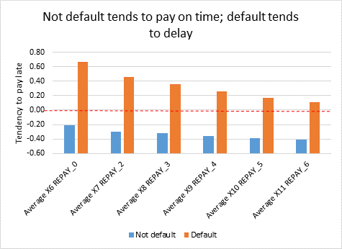
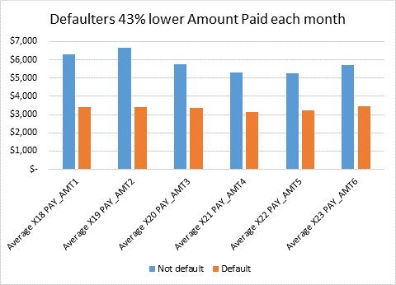
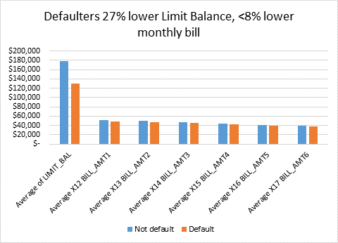
MS Excel mean values from initial 30K record dataset
The similarities in the outcomes for these graphs suggest we may be able to have a relatively small decision tree.
No practical differences seen based on gender or education.
It is important that persons not be discriminated against based on gender, race, income, or religion, and that objective means only be used.

Slide 4
Work Plan
Following our experience with R, we will randomly select a small (25%) subset of the “default of credit card clients” 30K record dataset to be a testing set, with the 75% balance as the training set.
The dependent variable is the “default payment next month” 0/1 variable (0= no default, 1 = yes default).
The Python Sklearn package will be imported and put to use.
The quality of the model will be estimated by a confusion matrix when the model is applied to the test dataset.

